Slide 1
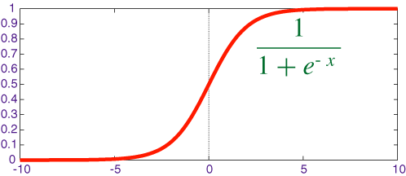
Input
1st hidden layer
2nd hidden layer
Output
Activation function
Abel
X1
Activation function
+ b
Activation function
Bob
X2
+ b
+ b
Chuck
X3
+ b
+ b
Dick
X4

Slide 2
4 inputs
ReLu
Output
1 node
1st layer
3 nodes
ReLu
2nd layer
2 nodes
Sigmoid

